Slide 1
AWS CLOUD SECURITY PROJECT
CloudSentinel
Cloud Security Detection & Auto-Response Platform
A highly-available AWS web platform with a built-in deception layer that detects reconnaissance activity, logs security events, and triggers real-time email alerts.
Youssef • Digital Egypt Pioneers Initiative (DEPI) — AWS Cloud Architecting Track

Slide 2
Team & Participants
The team behind the CloudSentinel implementation.
Khaled Wasef Helil
Eyad Mohammed Shaltoot
KW
EM
Samaa Esam Mostafa
Ali Mahmoud Ali
SE
AM
Mohamed Fathy Mohamed
Youssef Saber Salama
MF
YS
CloudSentinel — Cloud Security Detection & Auto-Response Platform
2

Slide 3
Project Overview
CloudSentinel is a self-defending cloud infrastructure built end-to-end on AWS. Beyond hosting a highly-available web application, it actively watches for attackers by exposing convincing decoy endpoints, logging every probe, and notifying the security team the moment something suspicious happens.
1
Isolated, Multi-AZ Network
A custom VPC with public/private subnets across two Availability Zones.
2
Deception-Based Detection
Fake /admin, /debug and /config routes bait and log attacker behaviour.
3
Instant Alerting
Core AWS Services
SNS pushes a real-time e-mail the moment a decoy path is triggered.
VPC & Subnets
Security Groups
S3
SNS
RDS (MySQL)
EC2
4
Elastic & Resilient
An Application Load Balancer + Auto Scaling Group keep the app online.
SSM
ALB
Auto Scaling
CloudSentinel — Cloud Security Detection & Auto-Response Platform
3

Slide 4
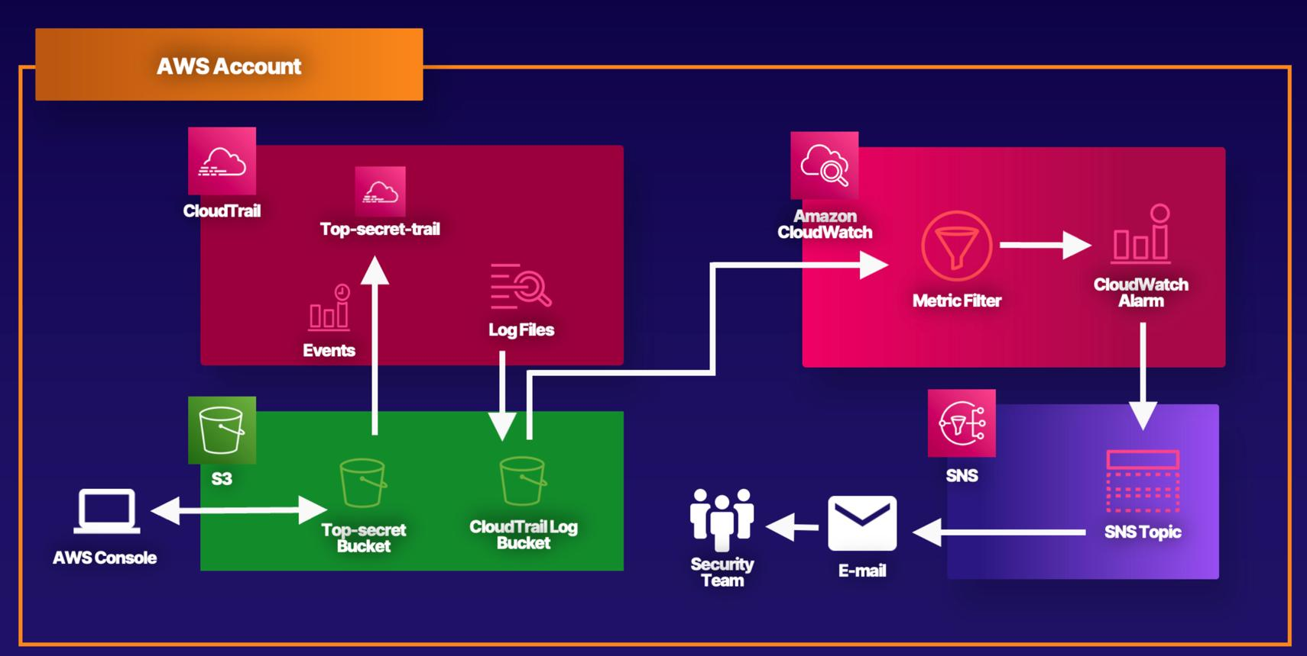
Security Monitoring Concept
The detection-and-response flow implemented across the project: activity is captured, filtered, and pushed to the security team as an alert.
CloudSentinel — Cloud Security Detection & Auto-Response Platform
4

Slide 5
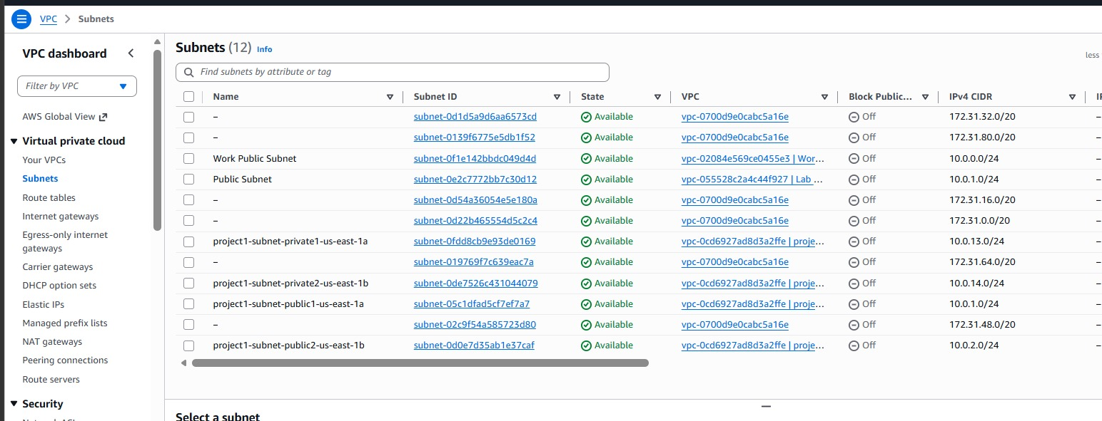
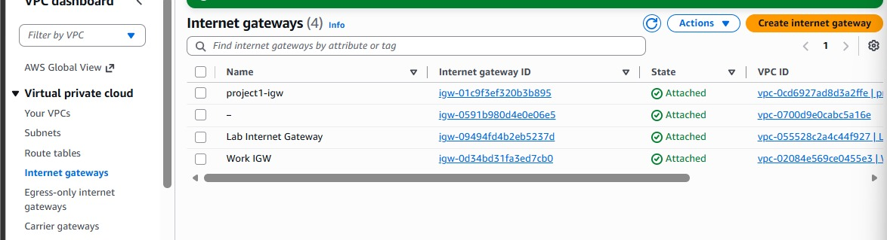
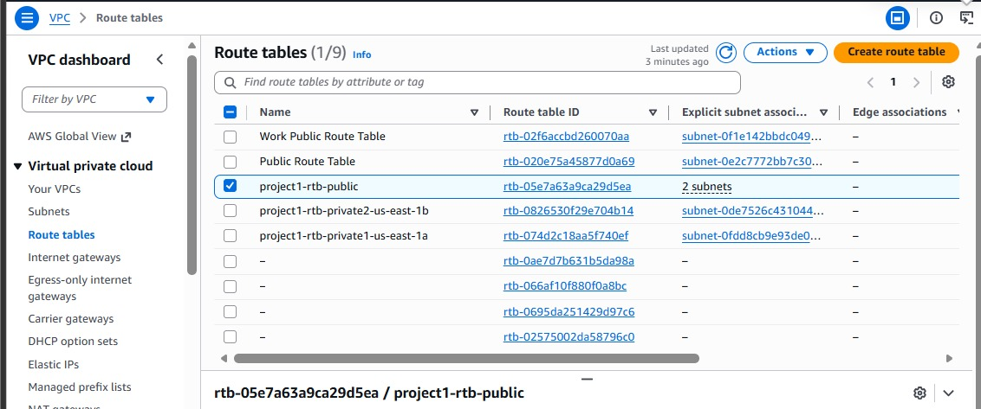
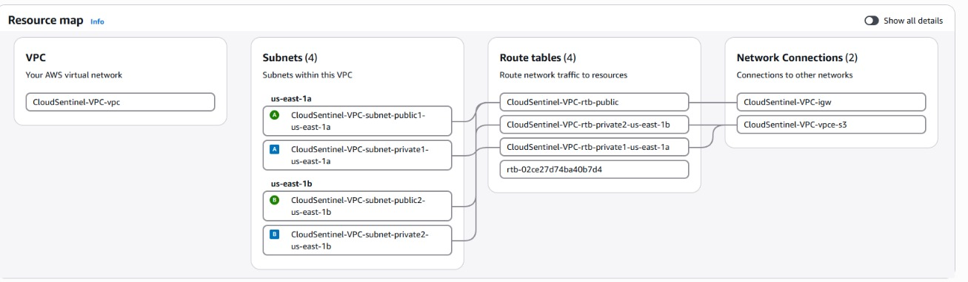
1
Building the Network Foundation (VPC)
A custom VPC spans two Availability Zones with public and private subnets, its own route tables, and an Internet Gateway.
Subnets across two Availability Zones
Internet Gateway attached to the VPC
Public route table configuration
VPC resource map — subnets, routes & gateways
CloudSentinel — Cloud Security Detection & Auto-Response Platform
5

Slide 6
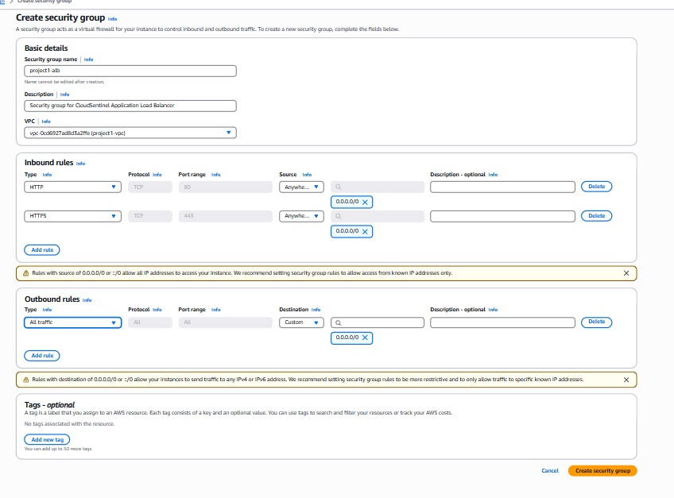
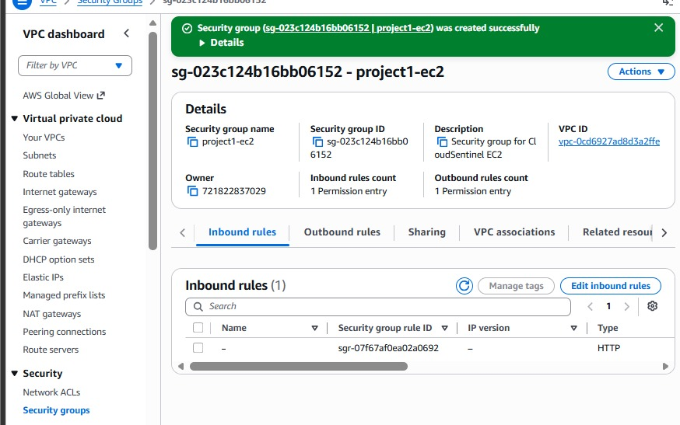
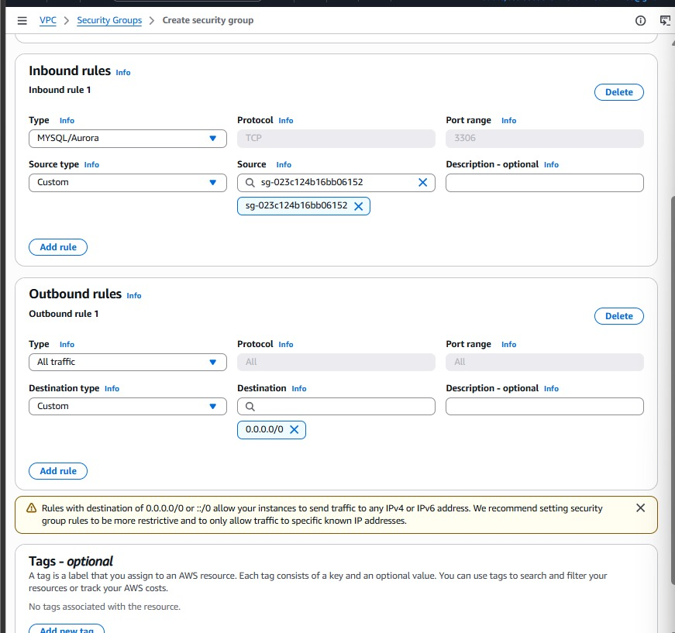
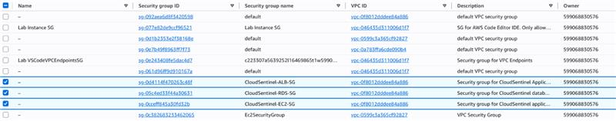
2
Locking Down Access (Security Groups)
Three dedicated security groups enforce least-privilege access between the ALB, the EC2 web tier, and the RDS database.
ALB security group — HTTP/HTTPS from the internet
EC2 security group created successfully
RDS security group — MySQL access from EC2 only
All three security groups, side by side
CloudSentinel — Cloud Security Detection & Auto-Response Platform
6

Slide 7
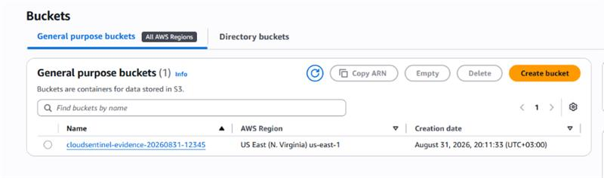
3
S3 Bucket for Evidence Storage
A dedicated S3 bucket stores security artifacts and logs collected by the platform.
cloudsentinel-evidence bucket, created in us-east-1
CloudSentinel — Cloud Security Detection & Auto-Response Platform
7

Slide 8
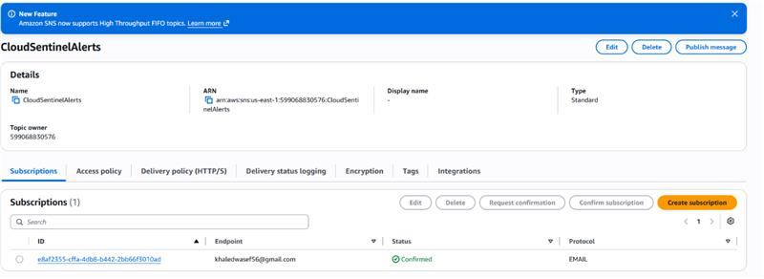
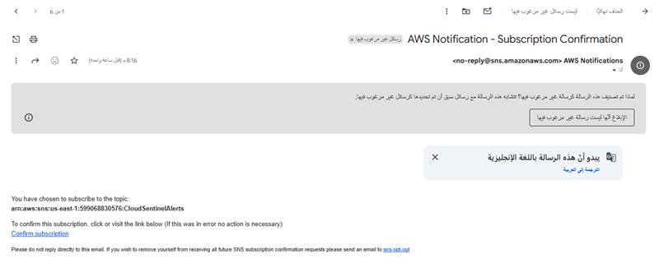
4
SNS — Real-Time Security Alerting
An SNS topic pushes an e-mail notification to the security team the instant a suspicious event is logged.
CloudSentinelAlerts SNS topic, confirmed e-mail subscription
Subscription-confirmation e-mail from AWS
How the alert reaches the team
Decoy path hit
→
Event logged (security.log)
→
SNS topic notified
→
E-mail sent to security team
CloudSentinel — Cloud Security Detection & Auto-Response Platform
8

Slide 9
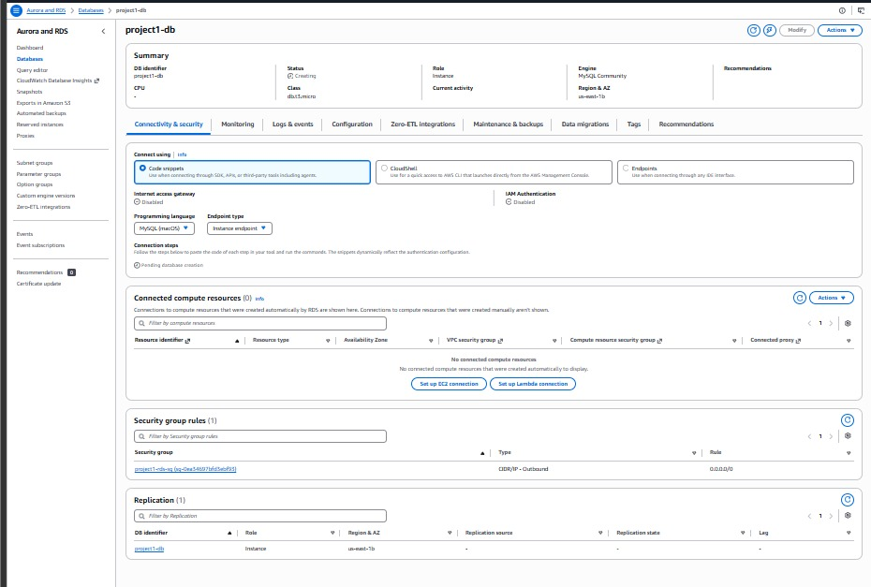
5
RDS — Managed Database Layer
A private MySQL instance on Amazon RDS backs the application, reachable only from the EC2 security group.
project1-db — MySQL Community instance provisioning
CloudSentinel — Cloud Security Detection & Auto-Response Platform
9

Slide 10
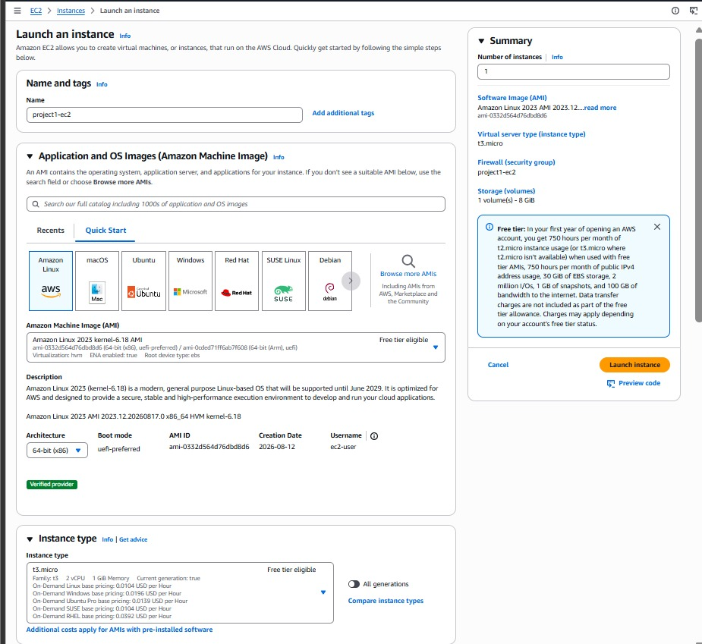
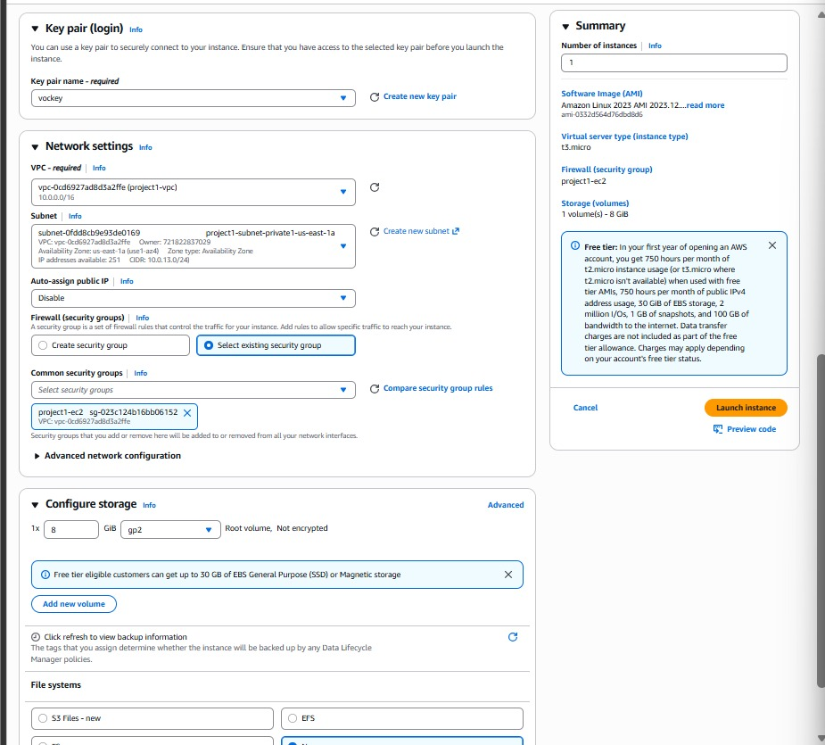
6
EC2 — Launching the Web Server
An Amazon Linux 2023 instance is launched into the private subnet with a scoped security group and key pair.
Choosing the AMI and instance type (t3.micro)
Key pair, VPC, subnet & security group settings
CloudSentinel — Cloud Security Detection & Auto-Response Platform
10

Slide 11
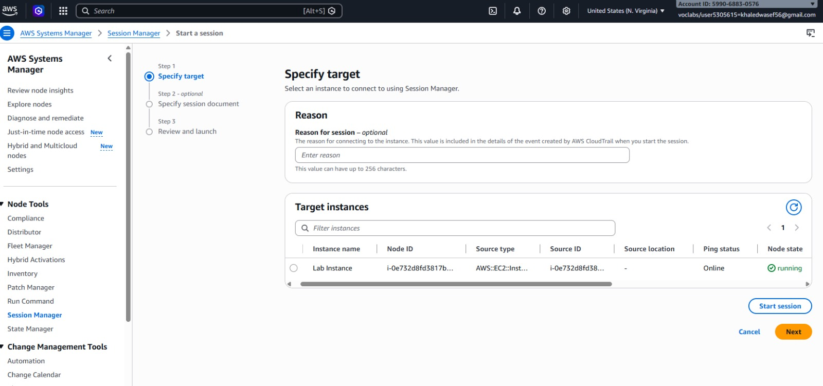
7
Secure Access with SSM Session Manager
No SSH keys, no open port 22 — the instance is reached through an IAM-authenticated, browser-based shell.
Session Manager — selecting the target EC2 instance
CloudSentinel — Cloud Security Detection & Auto-Response Platform
11

Slide 12
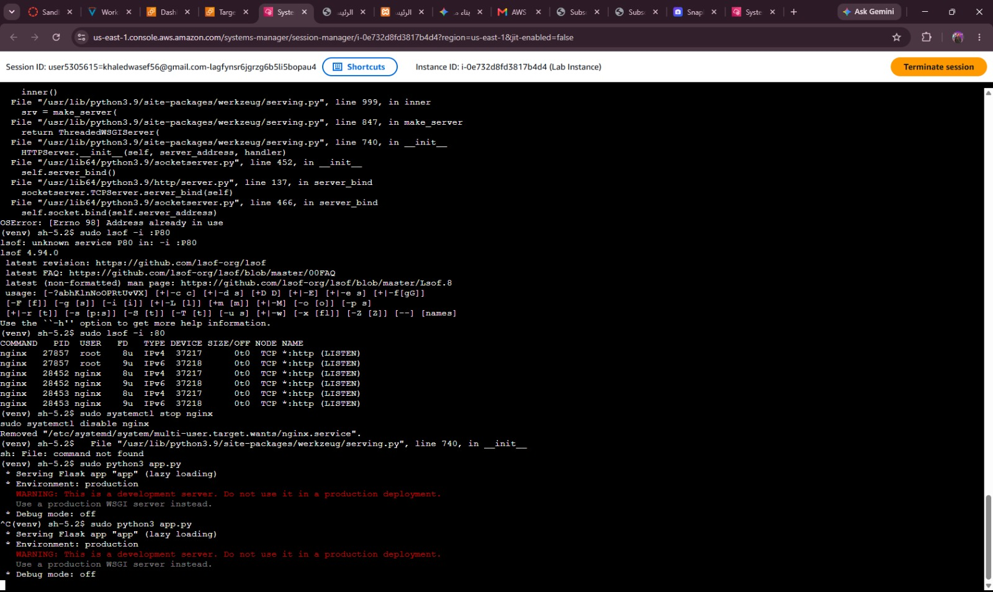
8
Deploying & Testing the Security App
Inside the session, a Flask app is deployed that serves the site and quietly logs any visit to a decoy route.
Test Results
curl http://localhost/
Returns the CloudSentinel HTML page
curl http://localhost/health
{"status":"healthy"}
Visit a decoy path (e.g. /admin)
403 Access denied — silently returned to the visitor
cat security.log
SECURITY_EVENT logged: DECEPTION_TRIGGER, path, risk score, source IP
Session Manager terminal — app deployed and running on port 80
CloudSentinel — Cloud Security Detection & Auto-Response Platform
12

Slide 13
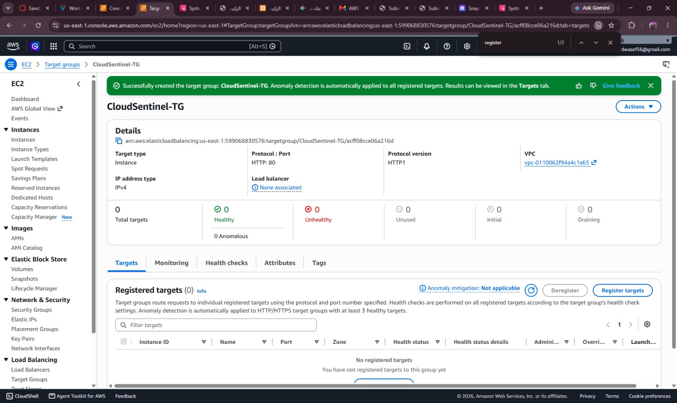
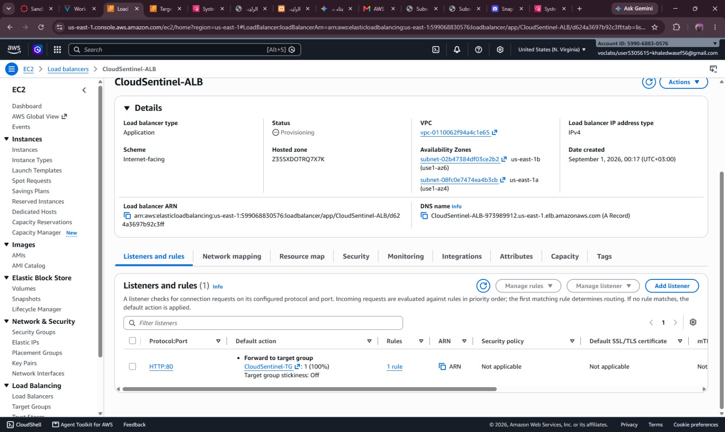
9
Application Load Balancer
The ALB distributes traffic across instances via a health-checked target group, enabling zero-downtime scaling.
Target group created — health checks active
CloudSentinel-ALB — internet-facing load balancer
CloudSentinel — Cloud Security Detection & Auto-Response Platform
13

Slide 14
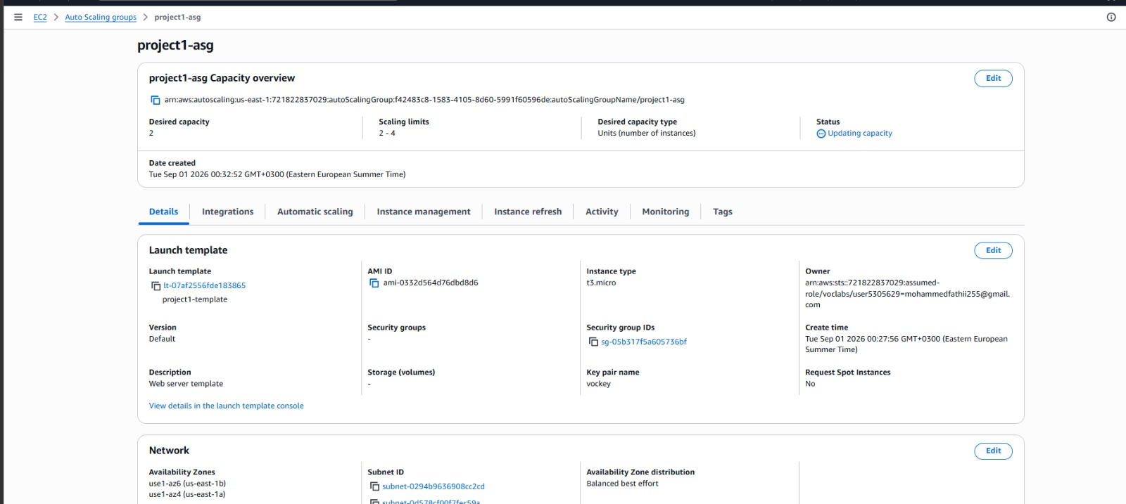
10
Auto Scaling Group
An ASG keeps 2–4 instances running behind the load balancer, replacing unhealthy nodes automatically.
project1-asg — desired capacity 2, scaling limits 2–4
CloudSentinel — Cloud Security Detection & Auto-Response Platform
14

Slide 15
Key Takeaways
End-to-end AWS infrastructure, security engineering, and automation practiced hands-on.
Secure Network Design
Deception-Based Detection
Multi-AZ VPC, subnetting, and least-privilege security groups.
Decoy endpoints that catch reconnaissance before real damage.
Real-Time Alerting
High Availability
SNS-driven e-mail notifications on suspicious activity.
ALB + Auto Scaling Group deliver resilience and elasticity.
Keyless Server Access
Managed Data Layer
IAM-authenticated SSM Session Manager instead of SSH.
RDS MySQL and S3 for structured and evidentiary storage.
Thank you.

